Slide 1
ENTERPRISE RESOURCE MANAGEMENT FINAL PROJECT
Team Nibble

Slide 2
TEAM MEMBERS
Varun Alla
Aakanksha Gupta
Abhishek Yadav
Dharahasini Gangalapudi

Slide 3
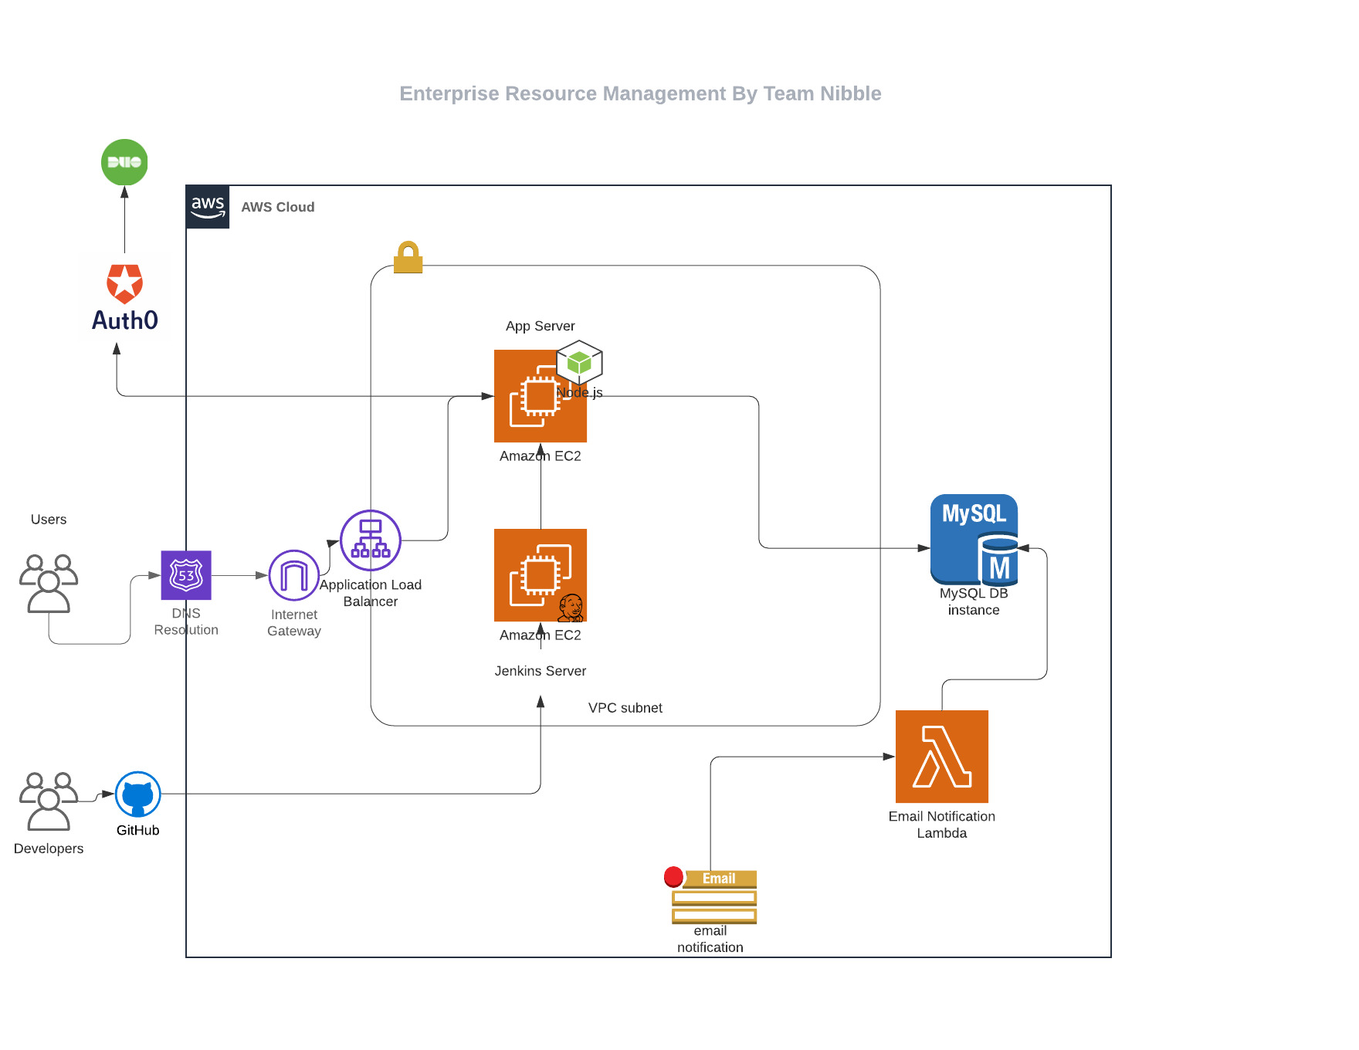
Architecture:

Slide 4
Technologies
FRONTEND – ANGULAR
FRONTEND STYLING – ANGULAR MATERIAL
SSO – AUTH0
BACKEND - Node js Express Server on EC2, AWS Lambda
SQL – MYSQL/AWS RDS
CI/CD - Jenkins

Slide 5
FEATURES
SSO – AUTH0 LOGIN
JENKINS INTEGRATION
SECURE TWITTER INTEGRATION
EMAIL NOTIFICATION AFTER ALLOCATION/DEALLOCATION REQUEST

Slide 6
ROLES
EMPLOYEE
HR
MANAGER
ADMIN

Slide 7
SSO – AUTH0

Slide 8
FEATURES
Auth0 User Store
DUO MFA
Role Based Access Control

Slide 9
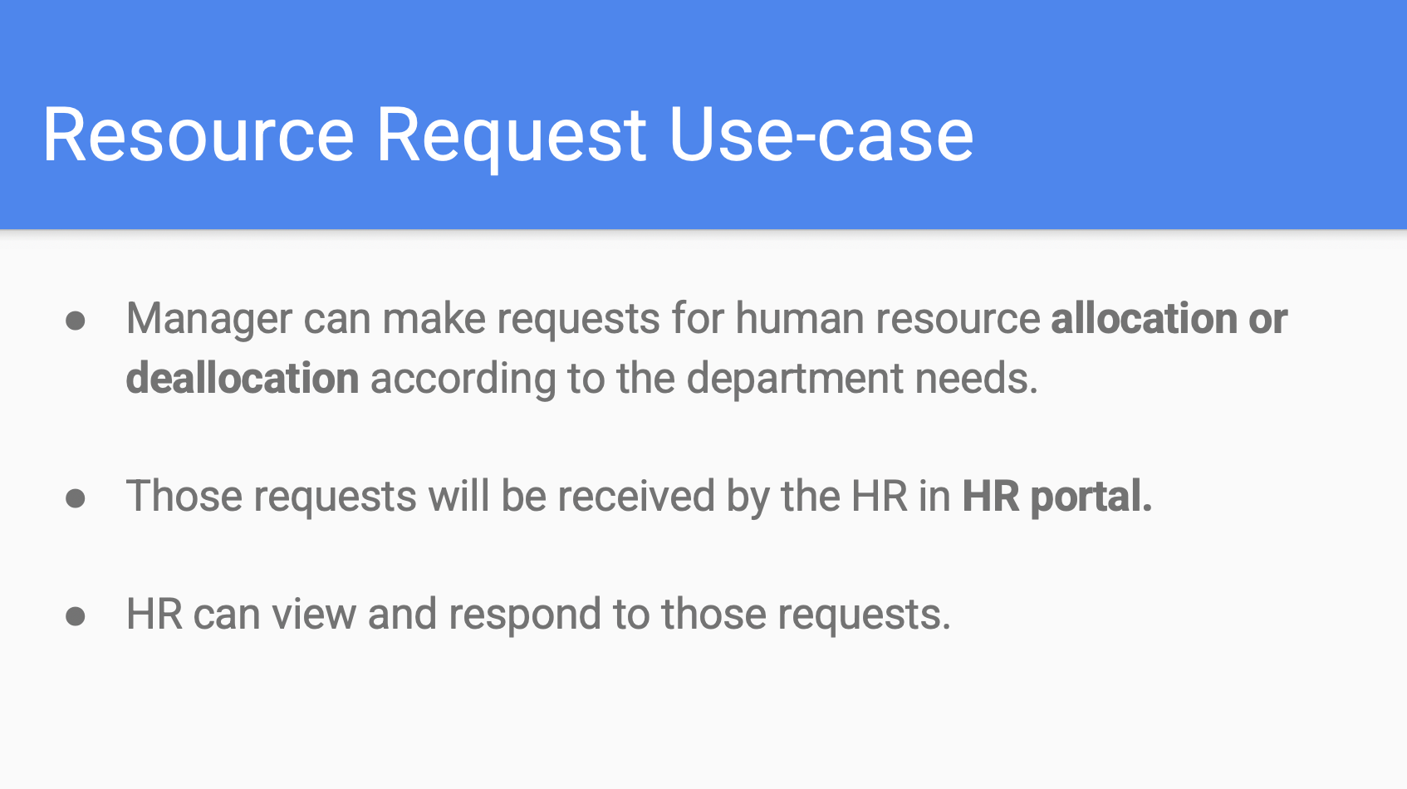

Slide 10
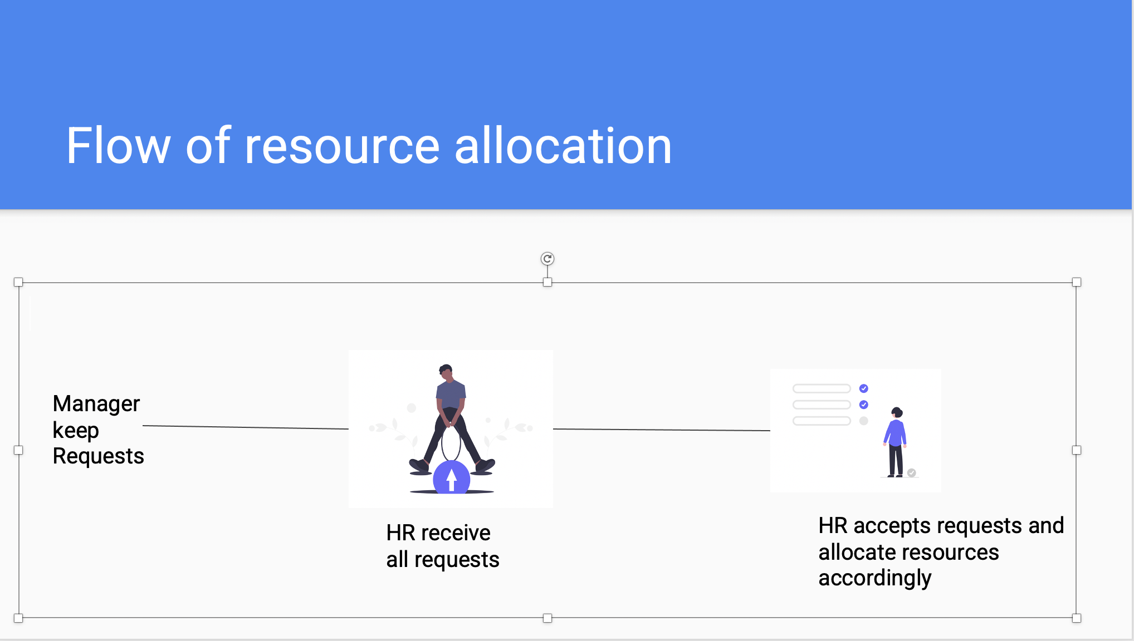

Slide 11
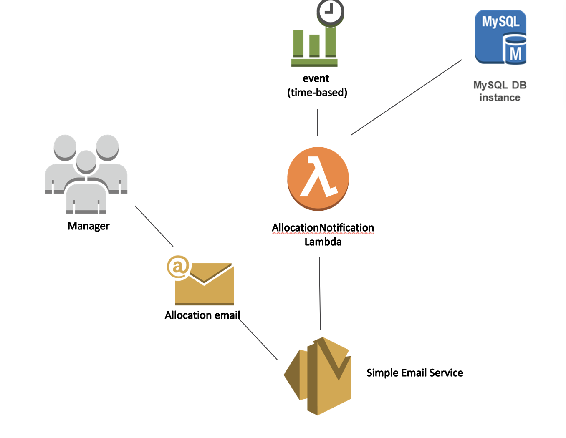

Slide 12
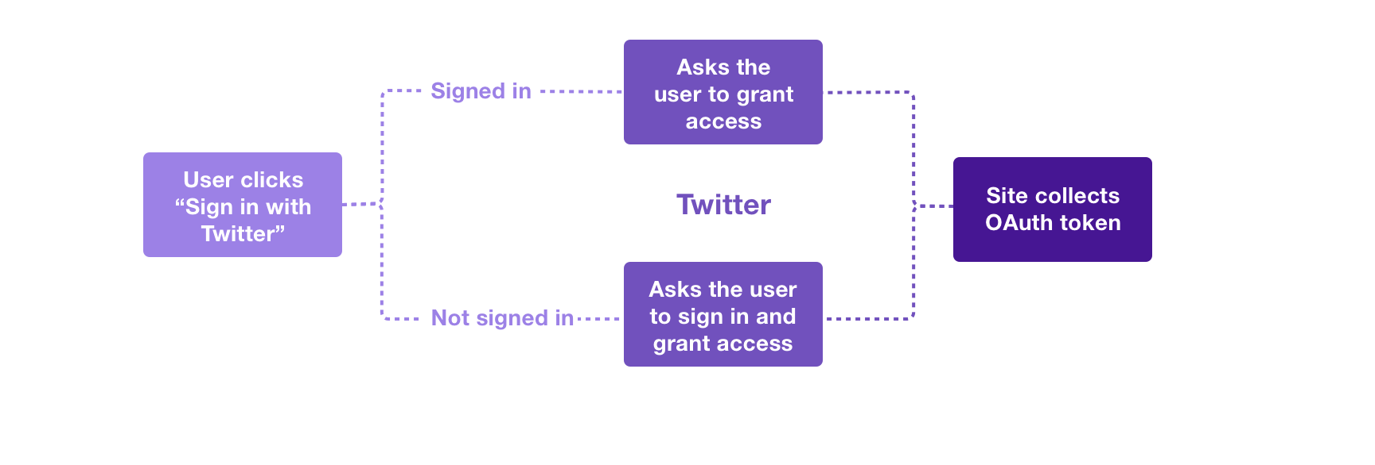
TWITTER 3 LEGGED AUTH USE CASE

Slide 13

APP WALKTHROUGH

